Slide 1
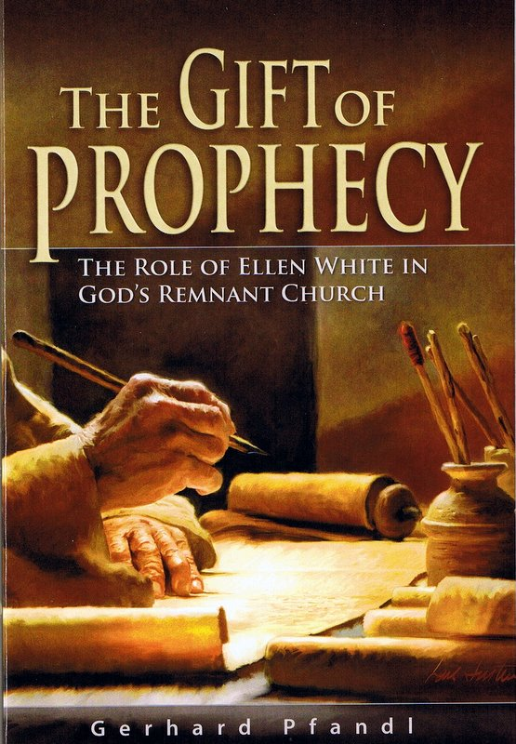
The Authority of Prophets
“Do not despise prophecies. Test all things; hold fast what is good.” 1 Thess. 5: 20,21

Slide 2
The Authority of Prophets
Sunday – The prophet as God’s mouthpiece
Monday – The authority of the Jesus – the “Incarnate Word.”
Tuesday – The authority of the written Word.
Wednesday – The authority of the spoken word
Thursday – The authority of non-canonical prophets
Friday – What the Seventh-day Adventist church affirms and denies about Ellen White

Slide 3
True or False
Prophets work for God, not for the church or any particular person.
To be authoritative, a prophet’s writing must be included in the canon of Scripture.
Jesus’ authority was subject to the decision of the temple system of His time.
The Bible contains authority when I find it there, but it does not have authority in itself.
Ellen White’s sermons and talk carried the same inspired authority as her written works.
Unless prefaced by words like “The Lord said to me,” or “I was told. . . “ her words are her personal opinion and of no more authority than anyone else’s.

Slide 4
The Authority of Prophets
Sunday – The Prophet as God’s Mouthpiece

Slide 5
The Process of Inspiration
Revelation 1:1, 2
“The revelation of Jesus Christ, which God gave him to show his servants what must soon take place. He made it known by sending his angel to his servant John, who testifies to everything he saw . . .”
God
Jesus
Angel
Prophet

Slide 6
The Authority of Prophets
Monday – The Authority of the Incarnate Word

Slide 7
Jesus is in a Unique Position
Matt. 21:23 – “By what authority. . .”
Jesus made them figure out the answer for themselves.
Matt. 28: 18 –”All power is given unto me in heaven and on earth.”
No Bible writer ever said such a thing!

Slide 8
Jesus is in a Unique Position
Matt. 28: 18 –”All power is given unto me in heaven and on earth.”
Divinity/Trinity -
Imperial or absolute authority
Humanity -
Delegated authority

Slide 9
Jesus’ Authority
What are four things Jesus did that showed unique authority?
  He forgave sins
  He drove out devils
  He claimed the right to judge people’s hearts
  He gave eternal life.

Slide 10
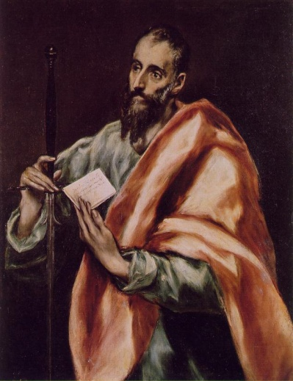
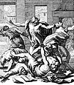
Difference Between Imperial and Delegated Authority
Acts 19:13-16
Paul had delegated authority from the Lord (v. 11)
These other men did not.

Slide 11
The Authority of Prophets
Tuesday – The Authority of the Written Word

Slide 12
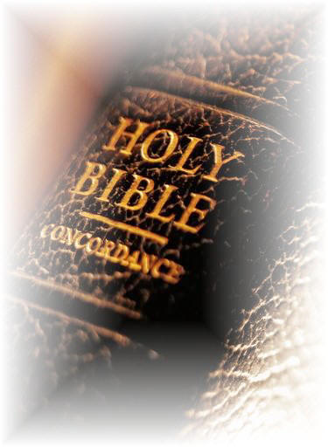
The “Canon” of Scripture
The “Canon” of Scripture refers to the accepted list of books appearing in the Bible.
Protestant Bibles have 66 books divided between the Old Testament and the New Testament.

Slide 13
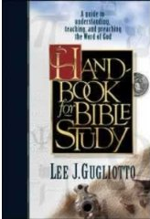
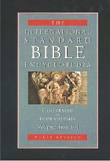
The “Canon” of Scripture
30 columns about the canon of scripture
New International Standard Bible Encyclopedia

Slide 14

The Authority of Scripture
So we are even more confident of the message proclaimed by the prophets. You will do well to pay attention to it, . . .
Above all else, however, remember that no one can explain by himself or herself a prophecy in the Scriptures.
For no prophetic message ever came just from human will, but people were under the control of the Holy Spirit as they spoke the message that came from God. 2 Peter 2: (GN)

Slide 15
The Authority of Scripture
Jesus - “The Scripture cannot be broken” (John 10:35)

Slide 16
What Different Religions Say
Some religions say: “The Bible plus . . . “

Slide 17
What Different Religions Say
Book of Mormon: “If the Book of Mormon is the Word of God, then it is to be accepted with equal authority, yea with greater authority, [than the Bible], since it purports to be not only the Word of God, but translated into English by the power of God.” (A Compendium of the Doctrines of the Gospel, p. 273).

Slide 18
What Different Religions Say
Mormon Church: “We believe the Bible to be the word of God as far as it is translated correctly; we also believe the Book of Mormon to be the word of God” (Articles Of Faith, #8).

Slide 19

What Different Religions Say
Christian Science: Science and Health with Key to the Scriptures encapsulates the teachings of Christian Science and Christian Scientists often call it their “textbook.” At Sunday services, passages from the book are read along with passages from the Bible. Eddy called the two books Christian Science's “dual and impersonal pastor.”

Slide 20
The Seventh-day Adventist Position
18. The Gift of Prophecy:
One of the gifts of the Holy Spirit is prophecy. This gift is an identifying mark of the remnant church and was manifested in the ministry of Ellen. G. White. As the Lord's messenger, her writings are a continuing and authoritative source of truth which provide for the church comfort, guidance, instruction, and correction. They also make clear that the Bible is the standard by which all teaching and experience must be tested. (Joel 2:28, 29; Acts 2:14-21; Heb. 1:1-3; Rev. 12:17; 19:10.)

Slide 21
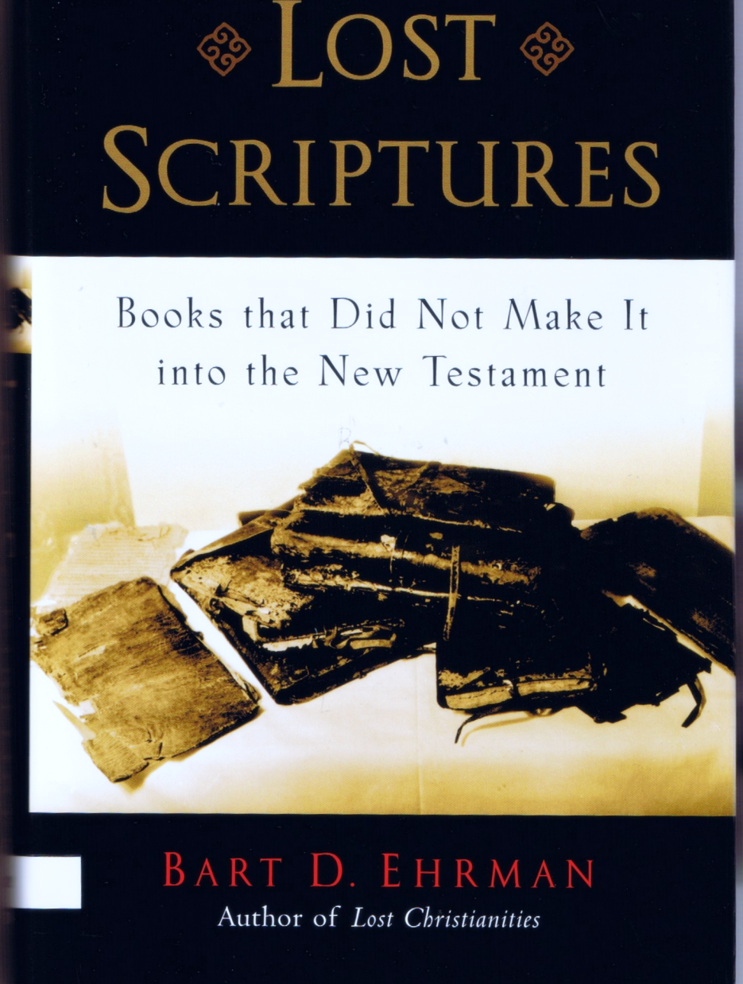
What do you know about these books?

Slide 22
What do you know about these books?
The Gospel of the Nazarenes
The Coptic Gospel of Thomas
The Gospel of Mary
The Second Treatise of the Great Seth
The Acts of Paul
The Apocalypse of Peter
The Secret Book of John

Slide 23
The Gospel of Mary
“Peter said to Him, ‘Since you have explained everything to us, tell us this also: What is the sin of the world?’ The Savior said ‘there is no sin, but it is you who make sin when you do the things that are like the nature of adultery, which is called sin.’”

Slide 24
The Second Treatise of the Great Seth
“Christ himself provides a first-hand description of how he descended into the man Jesus’ body, occupied it for the length of his ministry, and then died only in appearance.”
“I visited a bodily dwelling, I cast out the one who was in it previously, and I went in. And the whole multitude of the archons was disturbed.”

Slide 25
What do you know about these books?
Tobit
Bel and the Dragon
1 Maccabees
The History of Susanna

Slide 26
What do you know about these books?
Tobit 6:5-8, “If the Devil, or an evil spirit troubles anyone, they can be driven away by making a smoke of the heart, liver, and gall of a fish...and the Devil will smell it, and flee away, and never come again anymore.”

Slide 27
What do you know about these books?
1 Macc. 9:27. “. . . A prophet was not seen among them.”
These various books have no authority because there is no prophet among them.

Slide 28

What do you know about these books?
1 Macc. 9:27. “. . . A prophet was not seen among them.”
Old Testament
New Testament
400 years

Slide 29
The Authority of Prophets
Wednesday – The Authority of the Spoken Word

Slide 30
Case Study
In the 1860s, one Enoch Hayes was disfellowshipped by the Battle Creek church because he joined the army.
When Ellen White heard about it, she responded that she felt he should not be disfellowshipped for following his conscience.
The church changed the vote and received Enoch Hayes back into membership.
Why did the Battle Creek church change its vote?

Slide 31
Case Study
There is no indication that she had any revelation from the Lord about this
But she did have a revelation that stated
“Every true teacher will feel that should he err at all, it is better to err on the side of mercy than on the side of severity. — Education, p. 293.

Slide 32
The Authority of Prophets
Thursday – The Authority of the Non-Canonical Prophets

Slide 33
Non-Canonical Prophets
1 Chron. 29:29
2 Chron. 9: 29
2 Chron. 12:15
Book of Gad
Book of Iddo
Book of Nathan
Book of . . . .
No one questioned the authority of non-canonical prophets

Slide 34
Basic Principles
There are no degrees of inspiration. Inspiration is inspiration!
Inspired writings do not need to be verified by science or history because they are self-authenticating.
Non-canonical inspired writings do not take the place of the Bible nor are they an addition to it.
They are still authoritative.

Slide 35
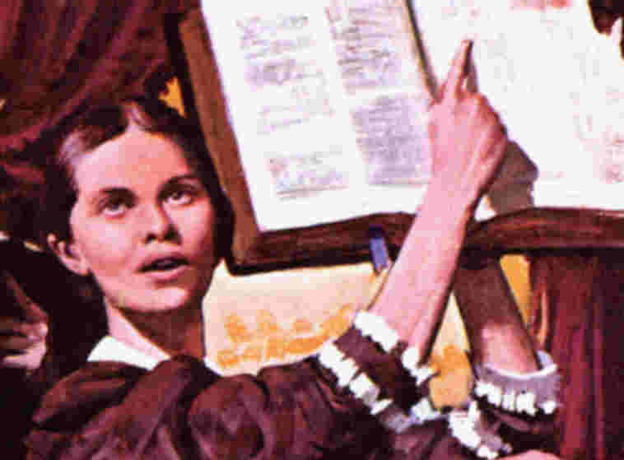
Another Classification of Prophets
Apocalyptic
    Parts of Daniel and the Book of Revelation.
Classical
    Most of what the other prophets wrote.
    These are messages to the churches.
Where does Ellen White fit?

Slide 36

Where Ellen White’s
Writings Fit
The Bible as a closed canon
Non-Canonical writings/Ellen White’s writings
Demarcation Line of Inspiration
Regular writings – non-inspired

Slide 37
Where Ellen White’s
Writings Fit
The Bible as a closed canon
Absolute authority
Testing tool
Subject to the Bible
Not subject to non-inspired writings
Non-Canonical writings/Ellen White’s writings
Demarcation Line of Inspiration
Regular writings – non-inspired

Slide 38
The Authority of Prophets
Friday – What Seventh-day Adventist Affirm and Deny

Slide 39
What Seventh-day Adventists Affirm
The Bible is divinely inspired.
The canon has 66 books.
The Bible is final authority.
The Bible is the Word of God in human language.
The Bible teaches affirms the gift of prophecy.
Ellen White had the gift of prophecy.
Her writings are authoritative.
Her writings provide guidance in understanding scripture.
The acceptance of her gift is important to the church.
Ellen White’s use of literary resources is the same as the Bible writers.

Slide 40
What Seventh-day Adventists Deny
That there are degrees of inspiration.
Ellen White’s writings are an addition to the canon of Scripture.
That Ellen White’s writings have the same authority as Scripture.
That Ellen White’s writings are the foundation of doctrine.
That the study of Ellen White’s writings replaces the study of Scripture.
That Scripture can only be understood through the lense of Ellen White’s writings.

Slide 41
What Seventh-day Adventists Deny
That the writings of Ellen White exhaust the meaning of Scripture.
Ellen White’s writings are essential for society in general.
That Ellen White’s writings are the product of mere Christian piety.
That her use of literary sources negates her inspiration.

